Slide 1


SMART INDIA HACKATHON 2025
TITLE PAGE
Problem Statement ID - SIH25020
Problem Statement Title- Development of indigenous contactless Integrated Track Monitoring Systems (ITMS) for Track Recording on Indian Railways
Theme- Smart Automation
PS Category- Hardware
Team ID- H35
Team Name - IronLogic

Slide 2
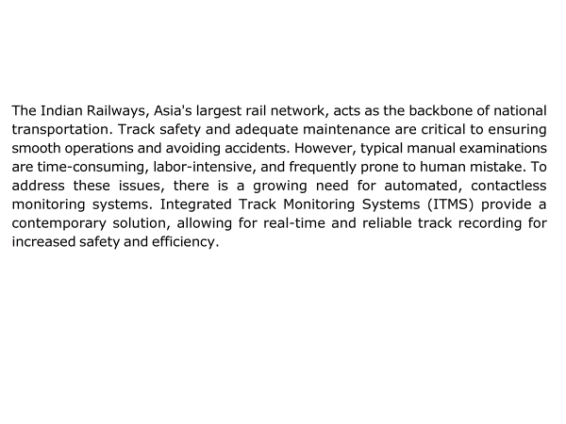
INTRODUCTION
IRONLOGIC

Slide 3
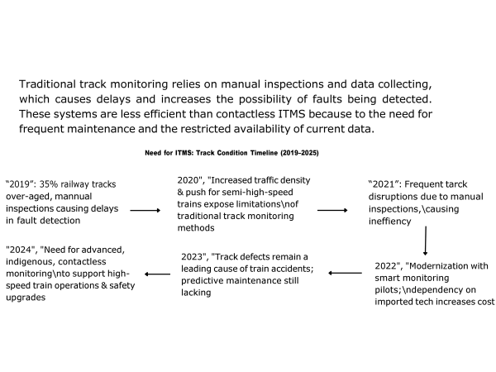
PROBLEM STATEMENT
IRONLOGIC

Slide 4
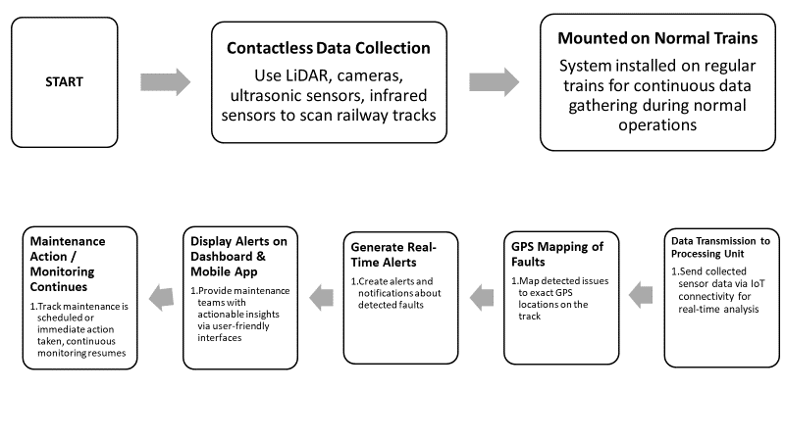
.
.
IRONLOGIC
PROPOSED SOLUTION

Slide 5
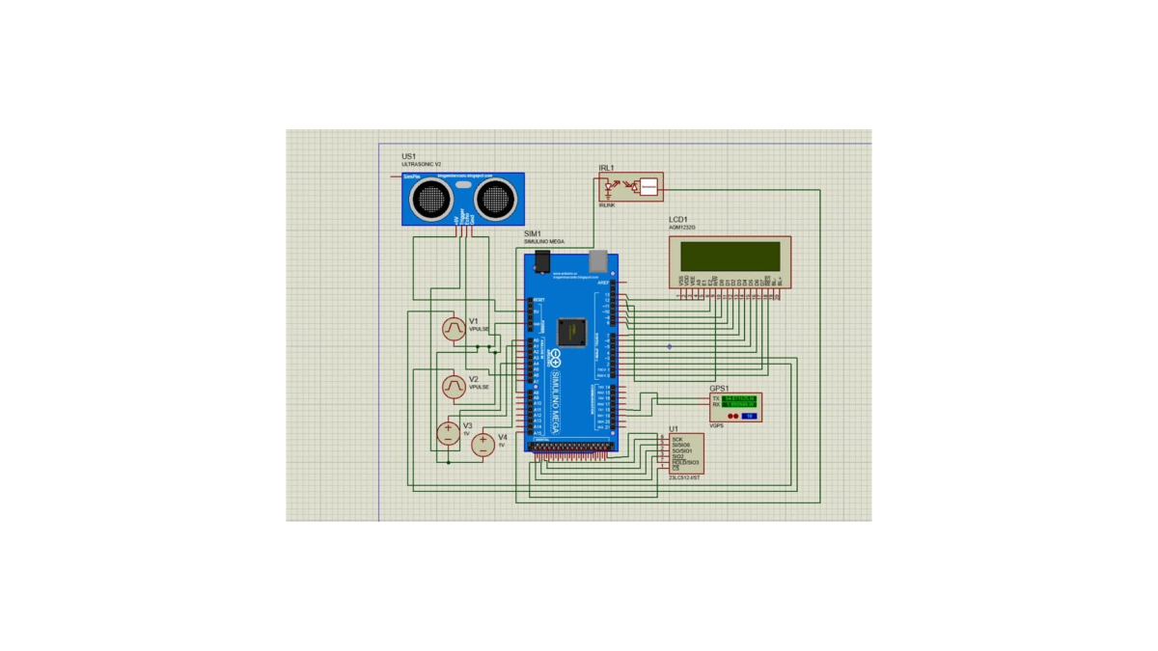
HARDWARE : CIRCUITING
IRONLOGIC

Slide 6
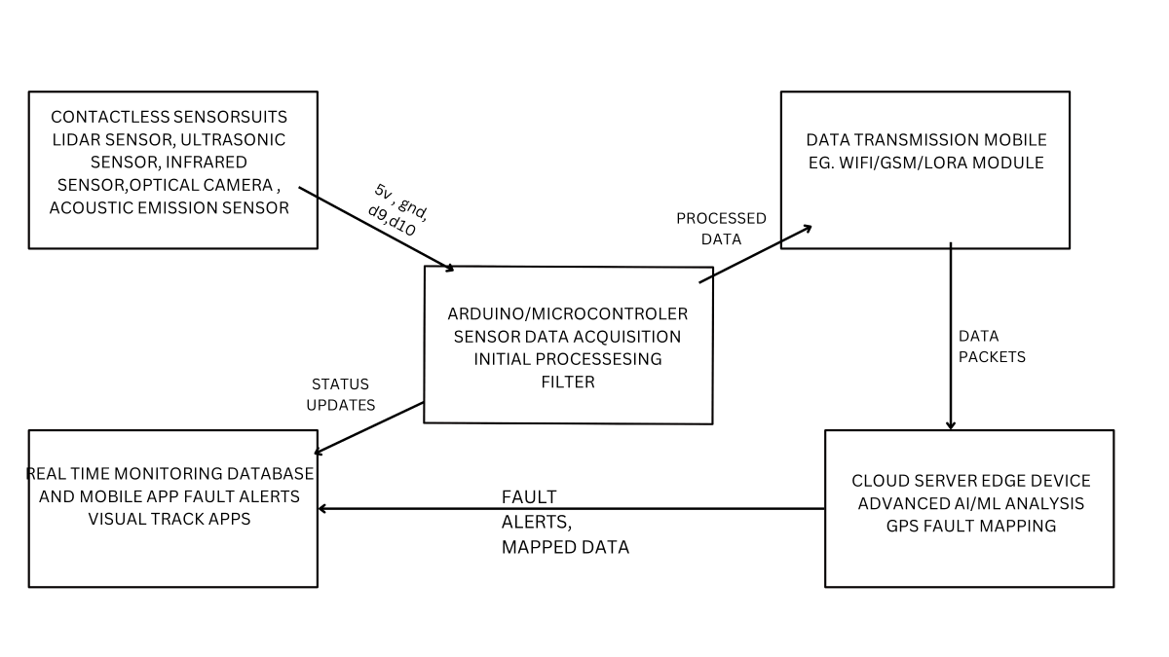
HARDWARE : FLOWCHART
IRONLOGIC

Slide 7
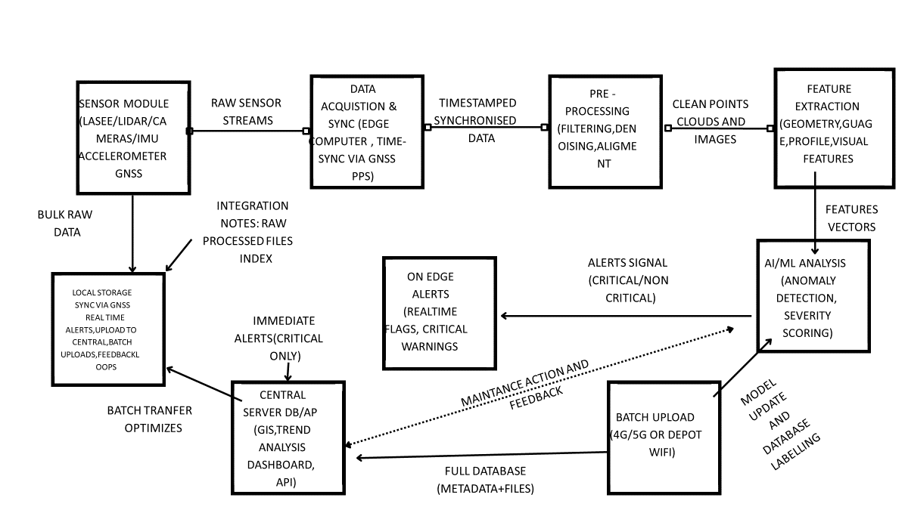
TECHNICAL APPROACH
IRONLOGIC

Slide 8
CONCLUSION
IRONLOGIC
Modern contactless, precision monitoring
Faster , more frequent inspections & real time alerts
Comprehensive data & integration
Safety ,efficiency & modernization benefits
Indigenous development &scale up

Slide 9

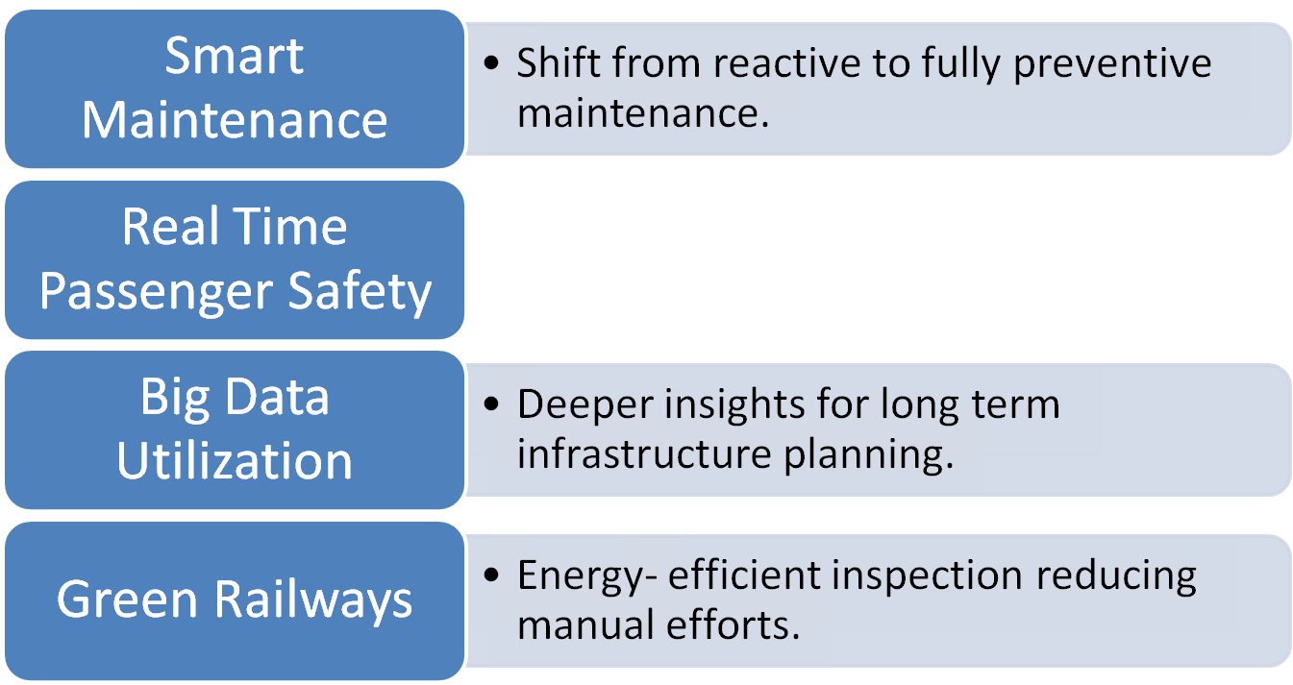

FUTURE SCOPE
Direct alerts for safer train operations.

Slide 10
RESEARCH AND REFERENCES
IRONLOGIC
EN 13848-1 & 2: Railway applications – Track geometry quality.
RDSO Specification TM/IM/448, Rev. 1: 2023.
Xu et al., “Railway track inspection using LiDAR and IMU sensor fusion,” IEEE Trans. Intell. Transp. Syst., 2021.
Indian Railways, R&D initiatives on Track Monitoring Systems, RDSO, 2023 write the main title and one line for each point
The New Indian Express
MillenniumPost
Introduction of Moden Track Inspection Technology in Indian Railways-
Integrated Track Monitoring System(ITMS)- New TRC

